Slide 1
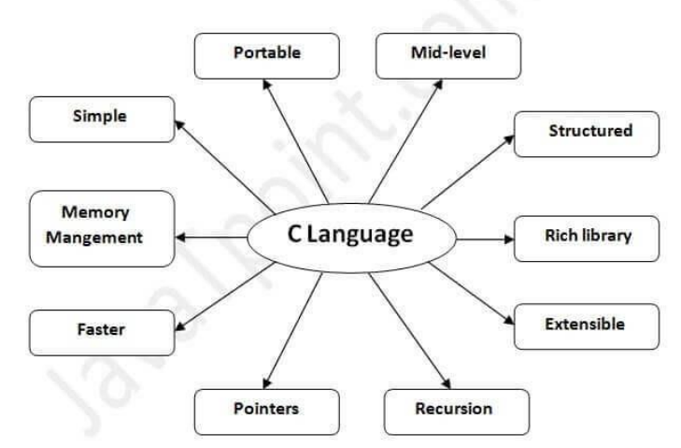
C NOTES

Slide 2
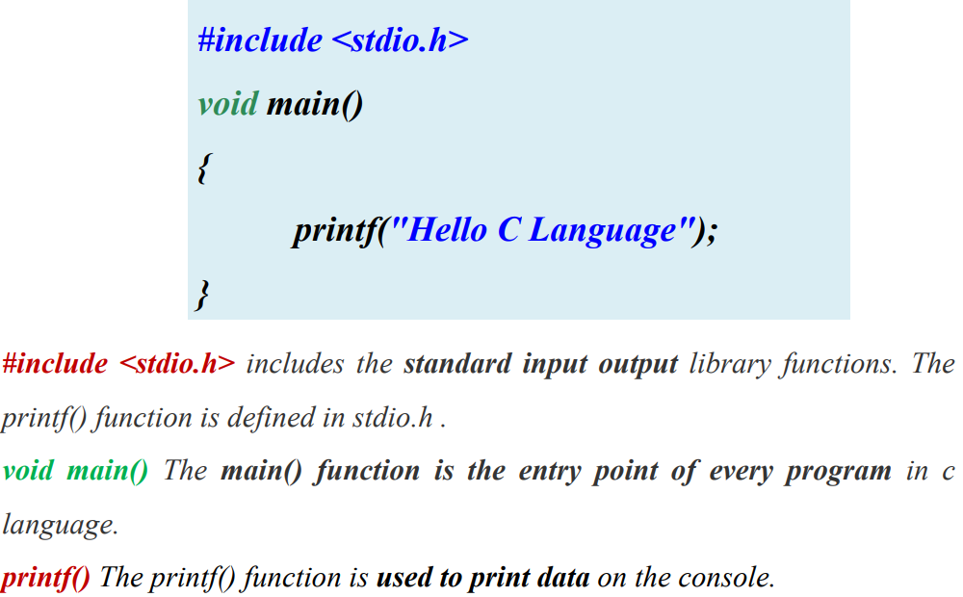

Slide 3
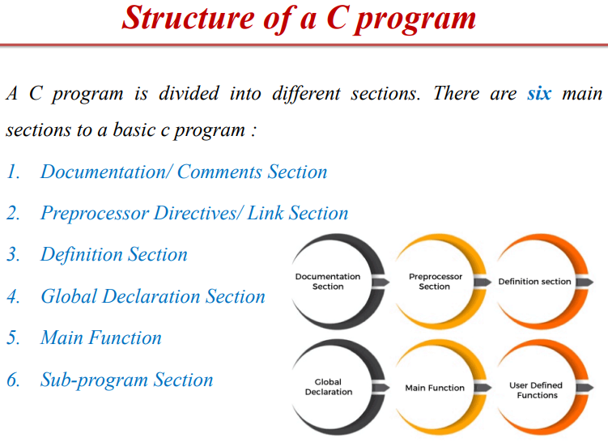
1 . // OR /*
include<stdio.h>
#define pi 3.14
Float a =22;
Main
Int ….

Slide 4
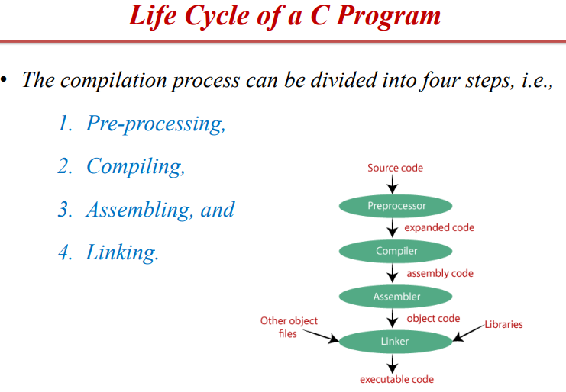
: Removes Comments , Include header File in Source Code , Replace Macro name with code
: generate assembly code
:Multiple units of object codes are linked to together in this step
PCAL
SOURCE CODE TO EXE CODE

Slide 5
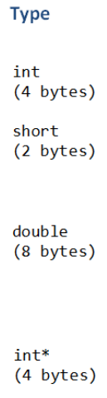
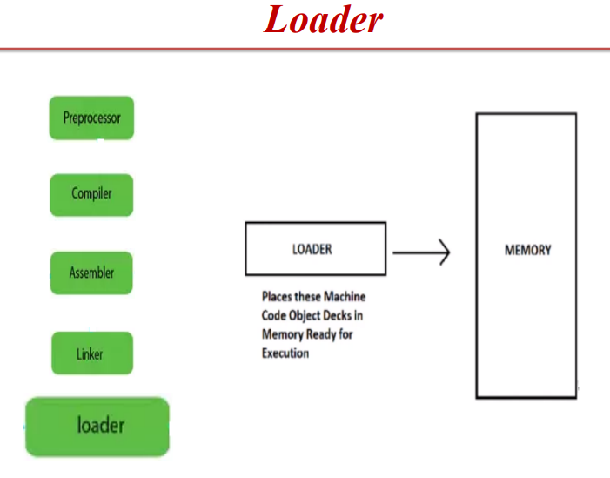

Slide 6
Properties : • Size of a variable • Name of a variable
• In programming, a variable is a container (storage area) to hold the data.
• To indicate the storage area, each variable should be given a unique name (identifier).
• Variable names are just the symbolic representation of a memory location.
For example:
int age; //declaration
int age=23; //Initialization

Slide 7
Keywords are predefined, reserved words used in programming that have special meanings to the compiler. Keywords are part of the syntax and they cannot be used as an identifier (variable/function name)
We can say that an identifier is a collection of alphanumeric characters that begins either with an alphabetical character or an underscore, which are used to represent various programming elements such as variables, functions, arrays, structures, unions, labels, etc.

Slide 8
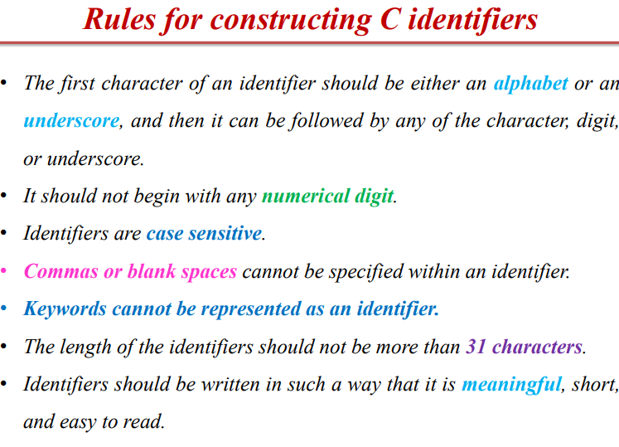
• It cannot include any special characters or punctuation marks (like #, $, ^, ?, . , etc.) except underscore ‘ _ ’
• There cannot be two successive underscores

Slide 9
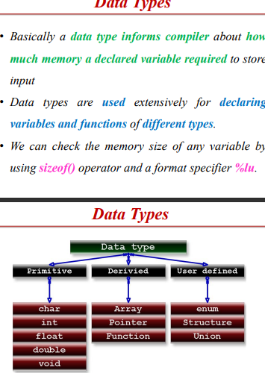

Slide 10
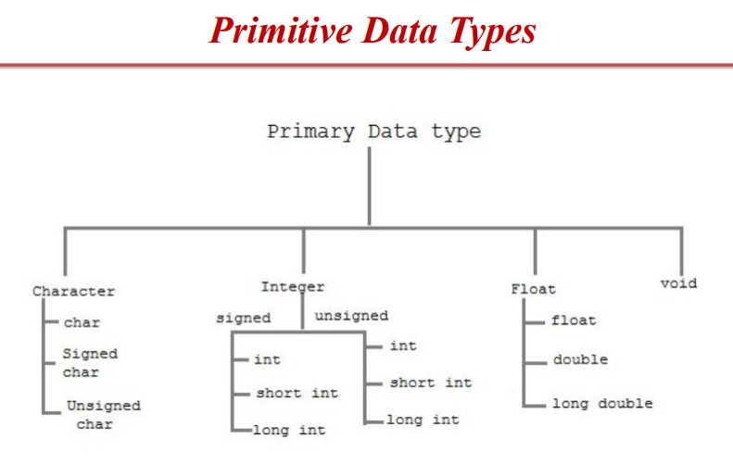
• Modifiers are C keywords that modify the meaning of fundamental data types.

Slide 11
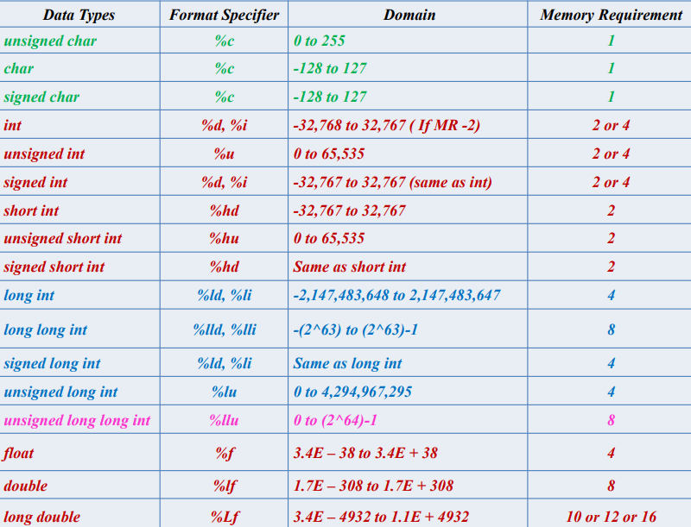

Slide 12
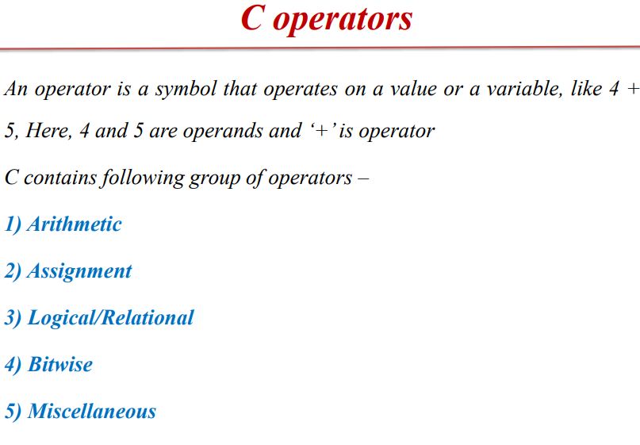

Slide 13
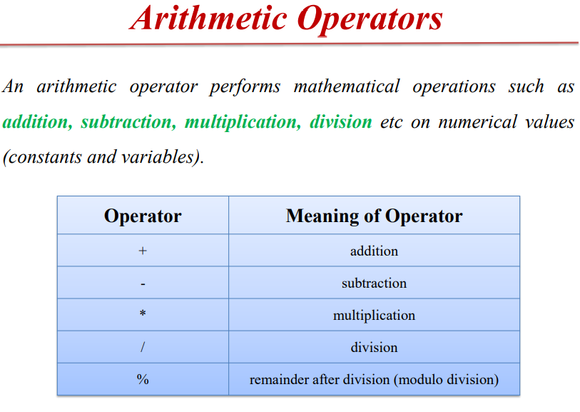
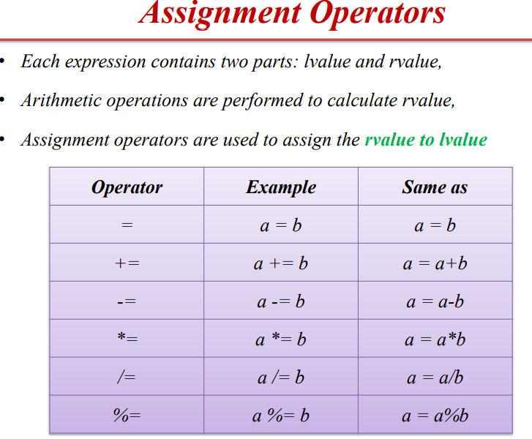

Slide 14
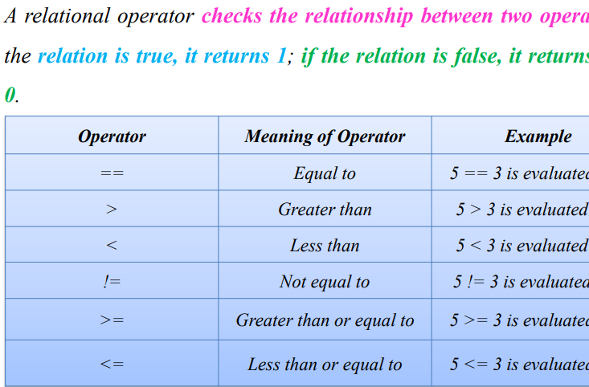
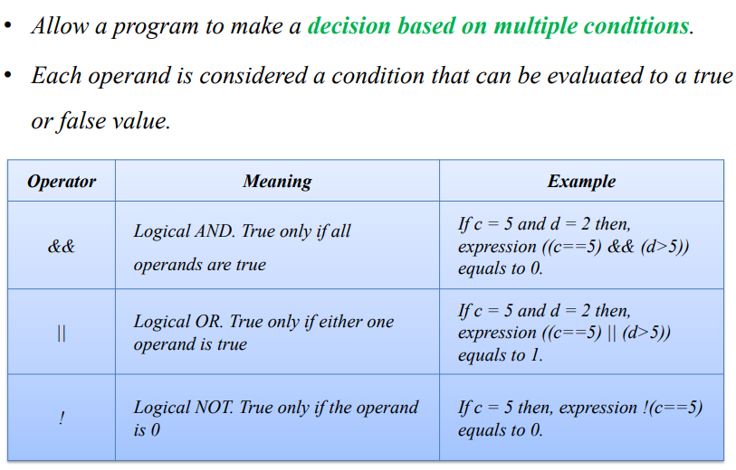
LOGICAL/RELATIONAL
1 and
2. Or
3. not

Slide 15
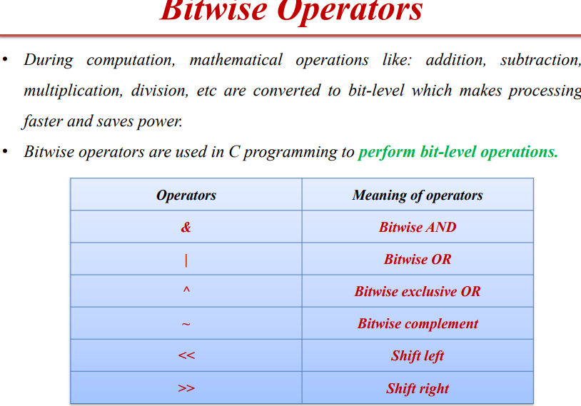
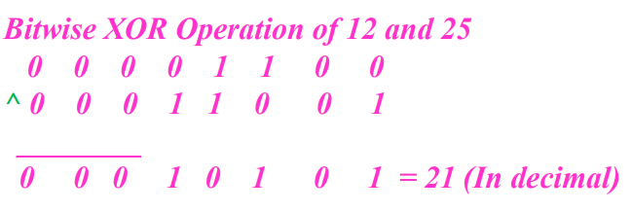

Slide 16
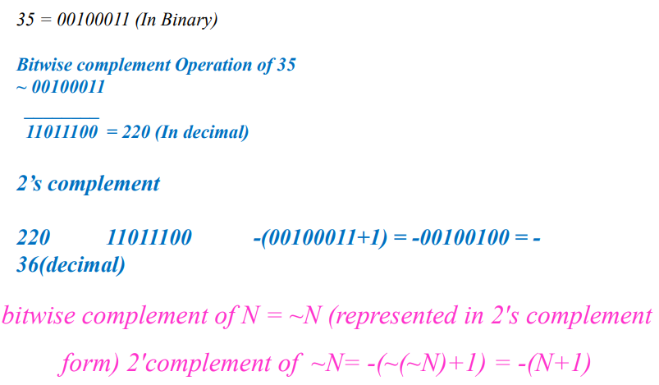
BITWISE COMPLEMENT : ~

Slide 17
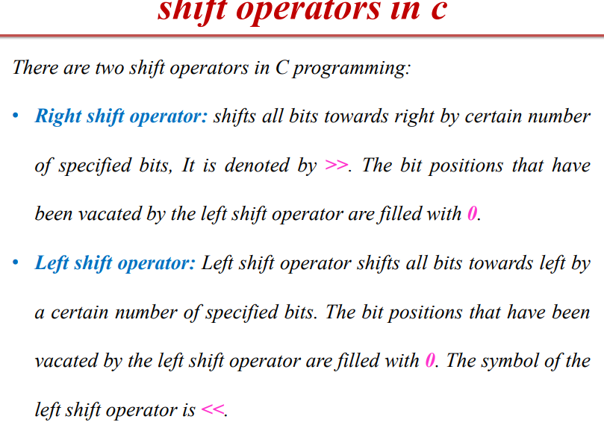
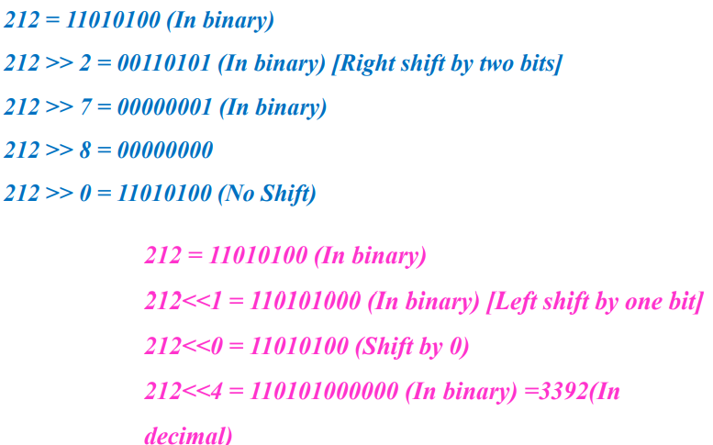

Slide 18
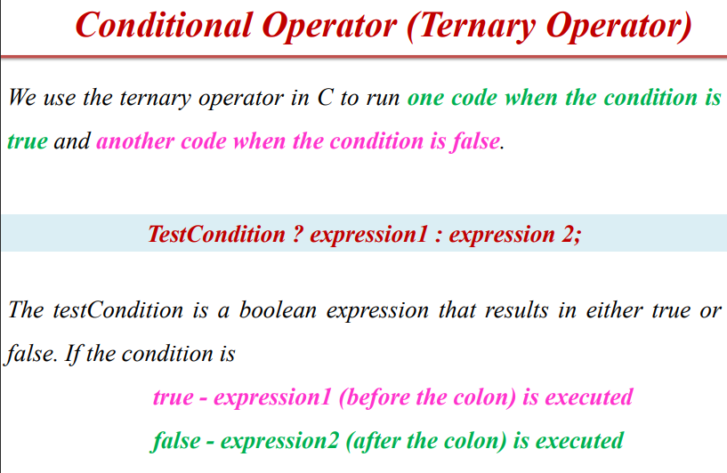

Slide 19
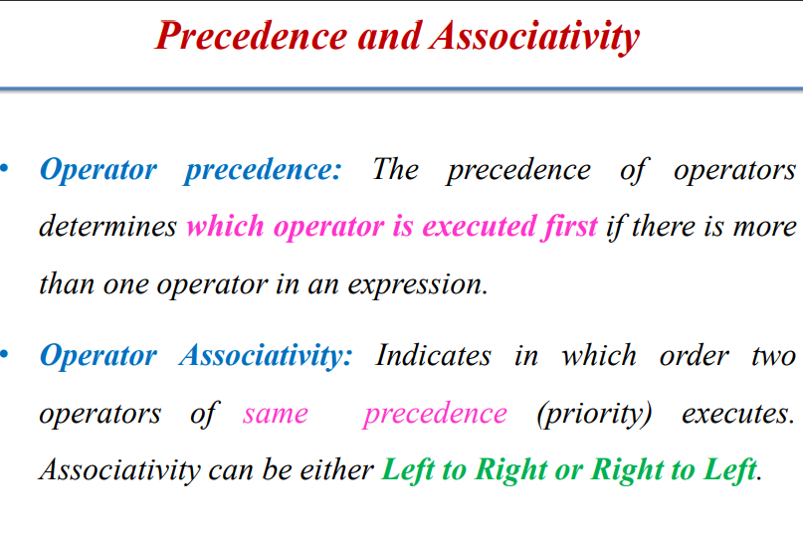
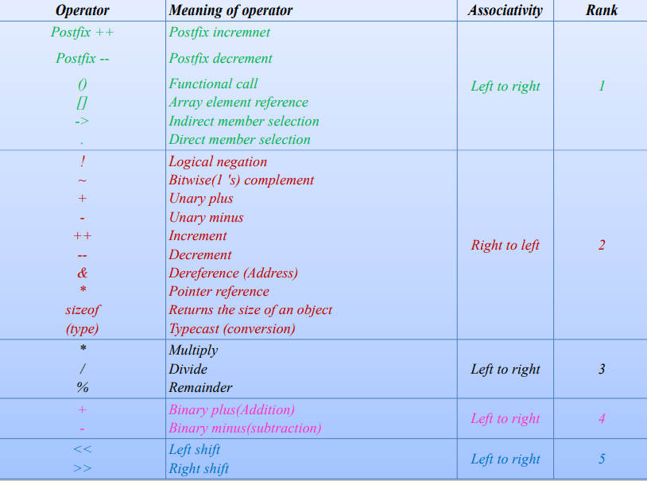

Slide 20
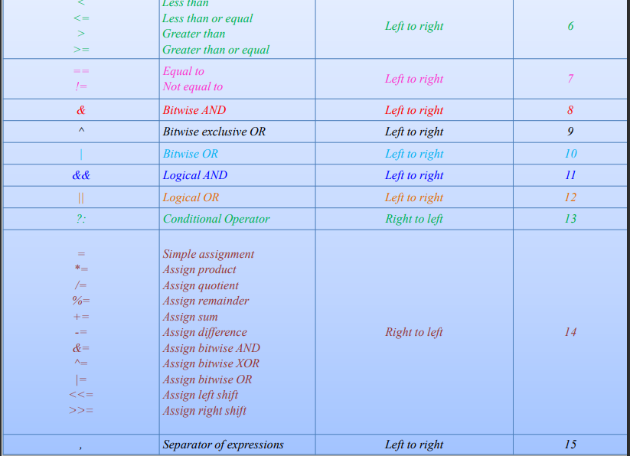

Slide 21
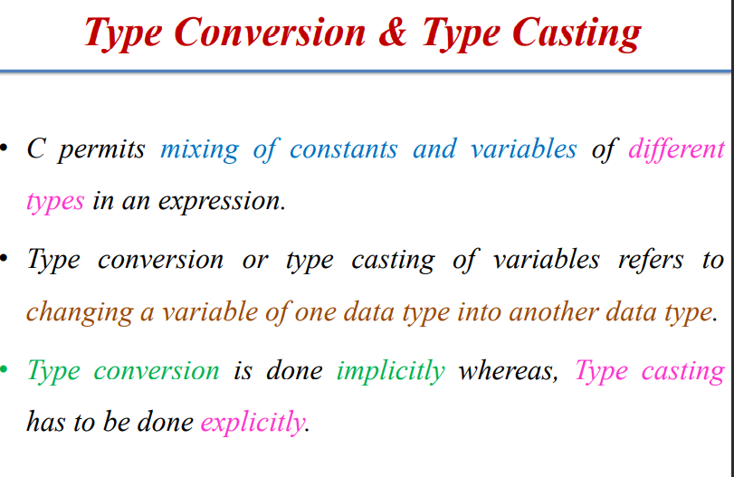
Implicit Conversion • C automatically converts any intermediate values to the proper type so that the expression can be evaluated without loosing any significance.
It is also known as widening conversion (type promotion) of the data type.

Slide 22
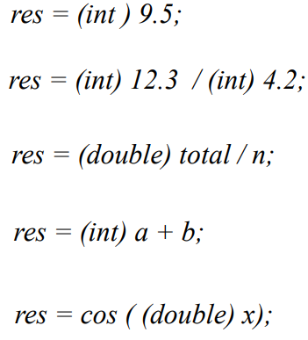
TYPE CASTING
Destination_datatype = (target_datatype) variable;

Slide 23
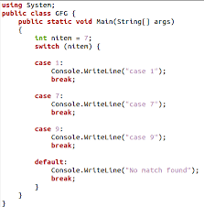
STATEMENTS

Slide 24
LOOPS
WHILE
DO WHILE
FOR

Slide 25
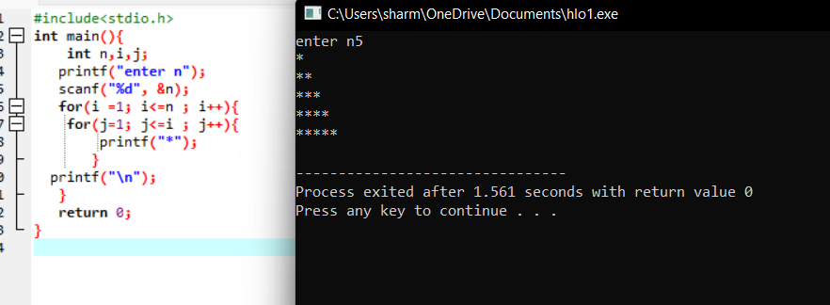
PATTRENS

